Slide 1
BLOCK CHAIN BASED CERTIFICATE AUTHENTICATION
UNDER THE GUIDANCE OF M.RAJESH SIR
BY
SHAIK.AAYESHA MOHAMMADI(18NG1A2138)
GATLA .TEJASRI (18NG1A1214)
GUNDUBOGULA.MOHANA(18NG1A1218)
GOGINENI.HARSHAVARDHAN(18NG1A1215)

Slide 2
TABLE OF CONTENTS
ABSTRACT
INTRODUCTION
LIMITATIONS OF EXISTING SYSTEM
PROPOSED SYSTEM
PROBLEM STATEMENT
SOFTWARE REQUIREMENTS
HARDWARE REQUIREMENTS
UML DIAGRAMS
IMPLEMENTATION
ALGORITHMS USED
ADVANTAGES
DISADVANTAGES
APPLICATIONS
TESTING
CONCLUSION

Slide 3
ABSTRACT
Lakhs of people getting degrees year after year, due to the lack of effective anti-forge mechanism, events that cause the graduation certificate to be forged often get noticed.
In order to solve the problem of counterfeiting certificates, our project will help to store the certificate in the block chain system and provide security.

Slide 4
INTRODUCTION
E-certificate generation system which manually creates the certificates based on current students data by using blockchain using a decentralized approach.
Our project will help to store the certificate in the block chain system and provide security. First ,the paper certificates are uploaded with student details and then using an algorithm a hash code value for the certificate is generated. Then the certificates are store in block chain. And these certificates are validated . By using block chain technology we can provide a more secure and efficient digital certificate validation.

Slide 5
LIMITATIONS OF EXISTING SYSTEM
It is time consuming as the system is handled manually.
Assurance of data security is not given.
In long run, it is difficult to maintain records.
Manpower requirement is huge.

Slide 6
PROPOSED SYSTEM
Our project will help to store the certificate in the blockchain system and provide security. First, the paper certificates are converted into digital certificates, store and retrieve them through a common portal.
Companies can retrieve valid certificates of students through this portal through permission for both the student and the institution that’s hosting certificates. Initially that issued certificates are scanned and upload to the portal through proper validation. The certificates are stored alongside the certificates are stored in various servers. The hashes of the certificates are stored in blockchain.

Slide 7
PROBLEM STATEMENT
This research to design and develop a system for dynamic and secure e certificate generation system using smart contracts in a blockchain environment.
In this work, we also illustrate our own blockchain in an open-source environment with a custom mining strategy as well as a smart contract.

Slide 8
SOFTWARE REQUIREMENTS
Operating system :Windows7,8,10 Ultimate,Linux,Mac.
Front-End :Python.
Coding Language :Python.
Software Environment :Anaconda (jupyter or spyder)0

Slide 9
HARDWARE REQUIREMENTS
System: Dual core
Hard Disk: 20 GB
RAM: 1GB
Processor: Intel corei5

Slide 10
Usecase diagram
A use case diagram is used to represent the dynamic behavior of a system.
It encapsulates the system's functionality by incorporating use cases, actors, and their relationships.
In our use case diagram it shows what tasks can be performed by user in our block chain based certificate authentication.
Our use case diagrams has user(actor),use case such as start,enter roll no,student name,……stop,etc.

Slide 11
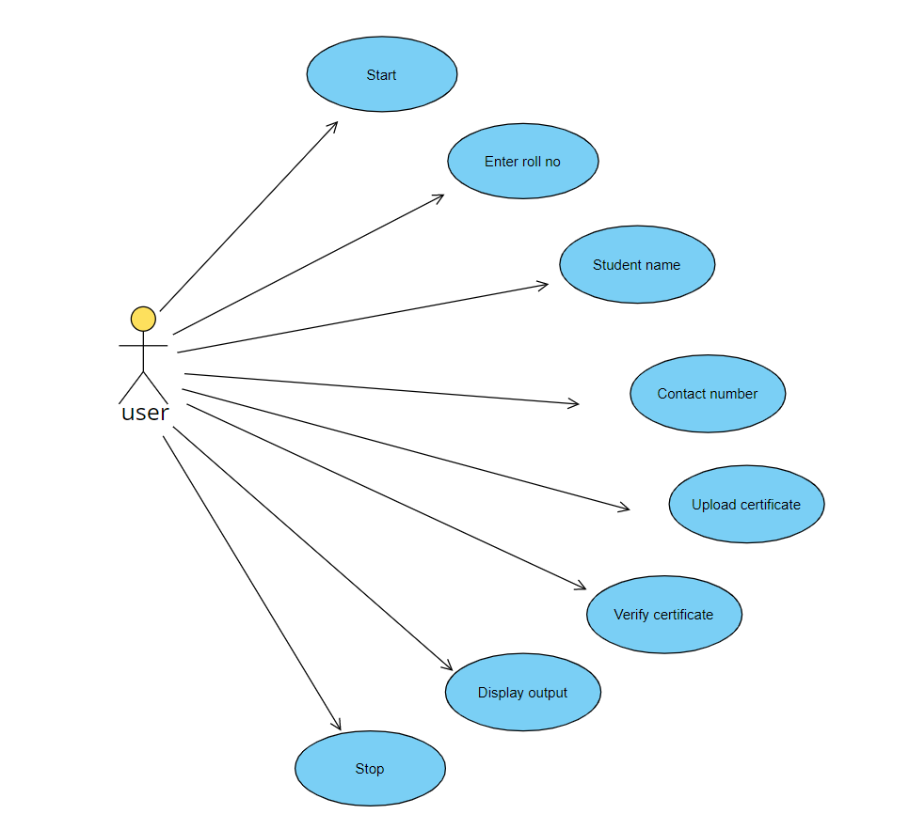

Slide 12
Class diagram
Class diagram is a static diagram. It represents the static view of an application.
Class diagram describes the attributes and operations of a class and also the constraints imposed on the system.
This Unified Modelling language diagram is type of a structured diagram that describes the structure of a Verifiable credential system by showing the system's classes, their attributes, operations and the relationships among objects.

Slide 13
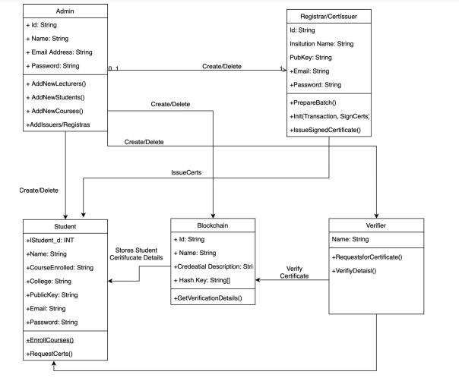

Slide 14
SEQUENCE DIAGRAM
Sequence diagrams are a popular dynamic modeling solution in UML.
It depicts the objects involved in the scenario and the sequence of messages exchanged between the objects needed to carry out the functionality of scenario.
Sequence diagrams are typically associated with use case realizations in the logical view of the system under development

Slide 15
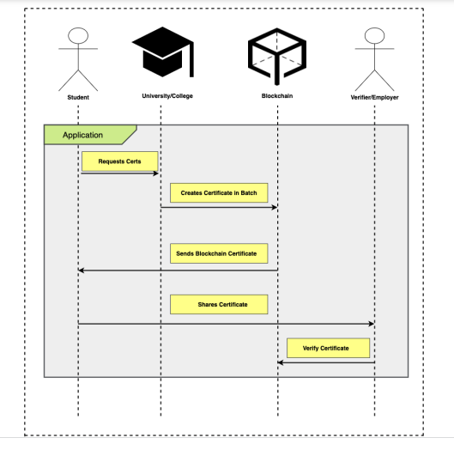

Slide 16
Activity diagram
Activity diagram is basically a flowchart to represent the flow from one activity to another activity.
Activity diagrams deal with all type of flow control by using different elements such as fork, join.
It captures the dynamic behavior of the system.

Slide 17
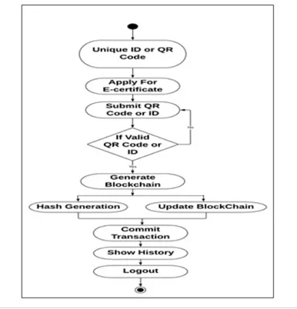

Slide 18
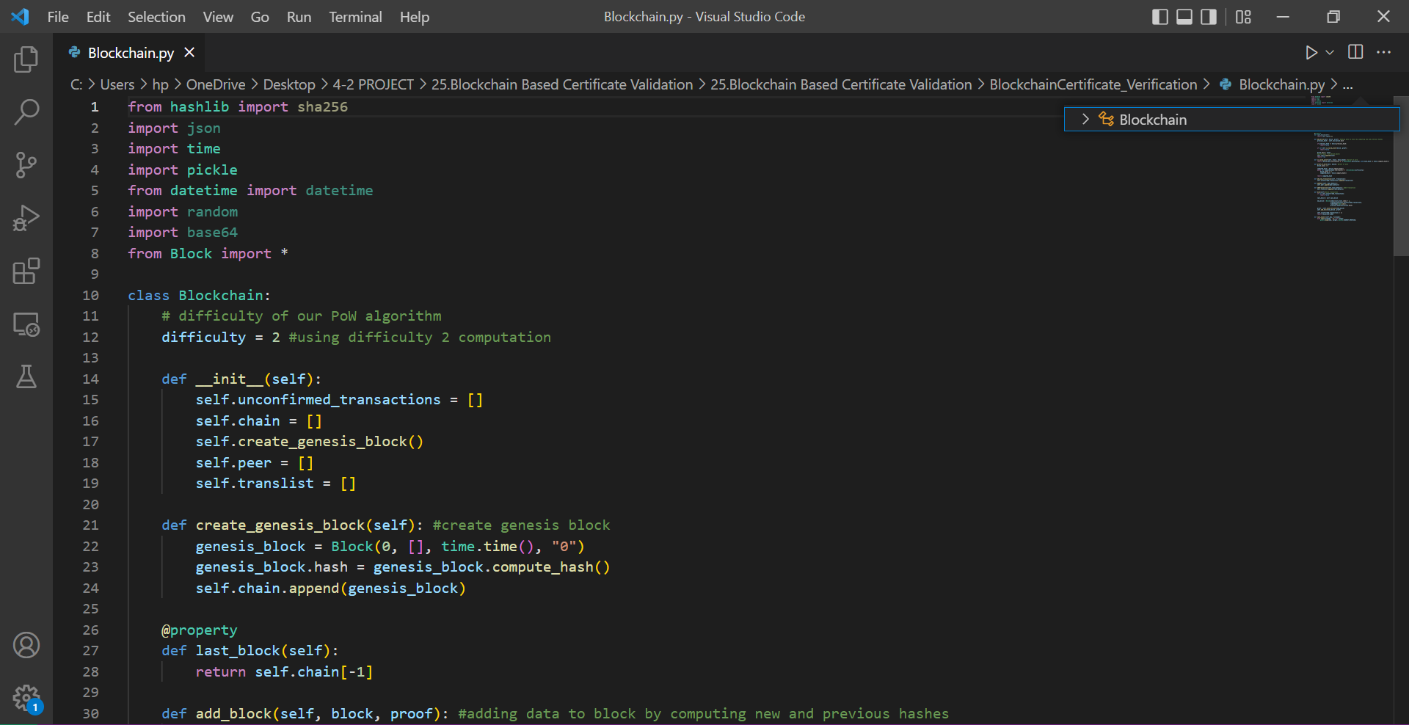
IMPLEMENTATION

Slide 19
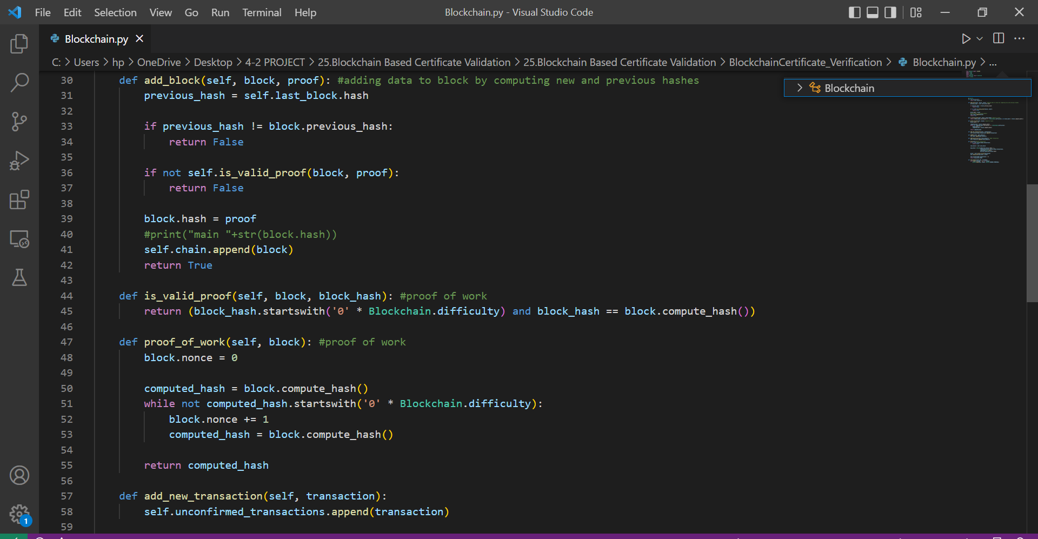

Slide 20
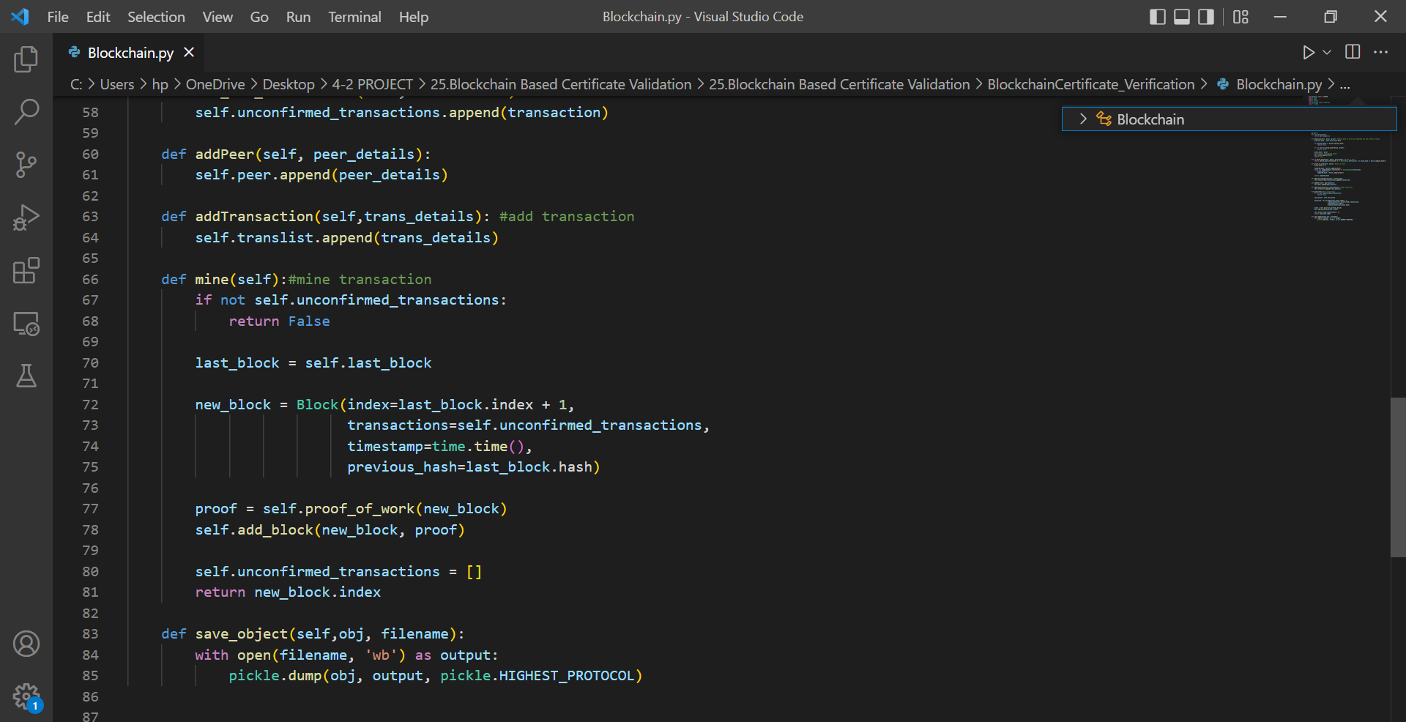

Slide 21
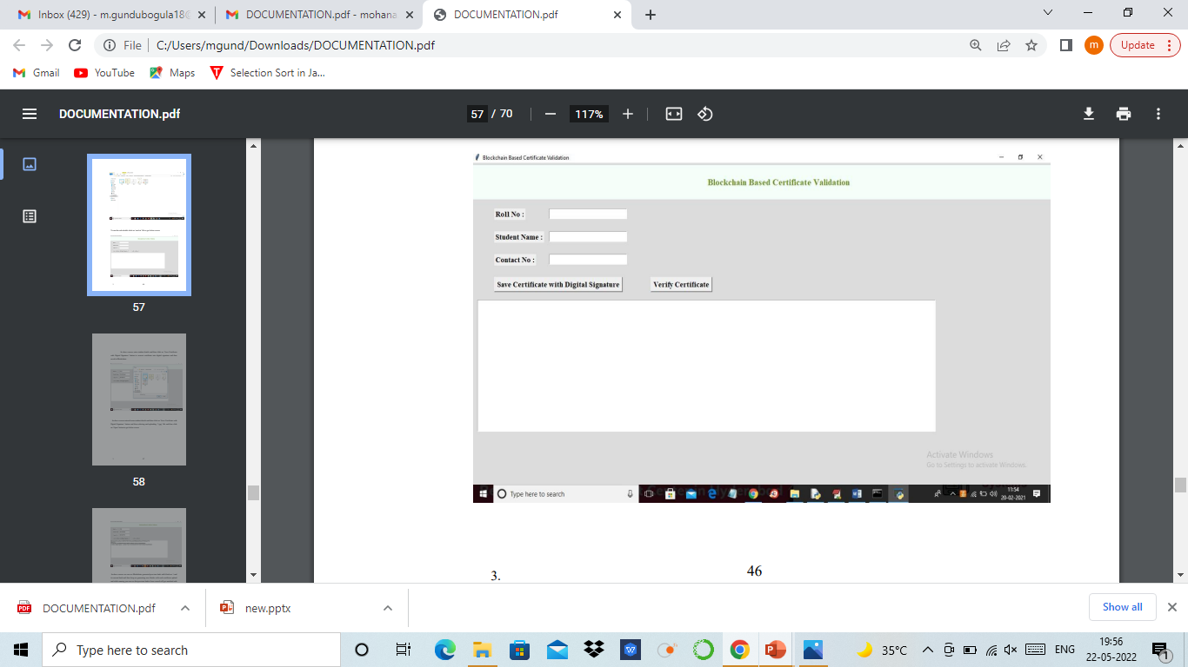

Slide 22
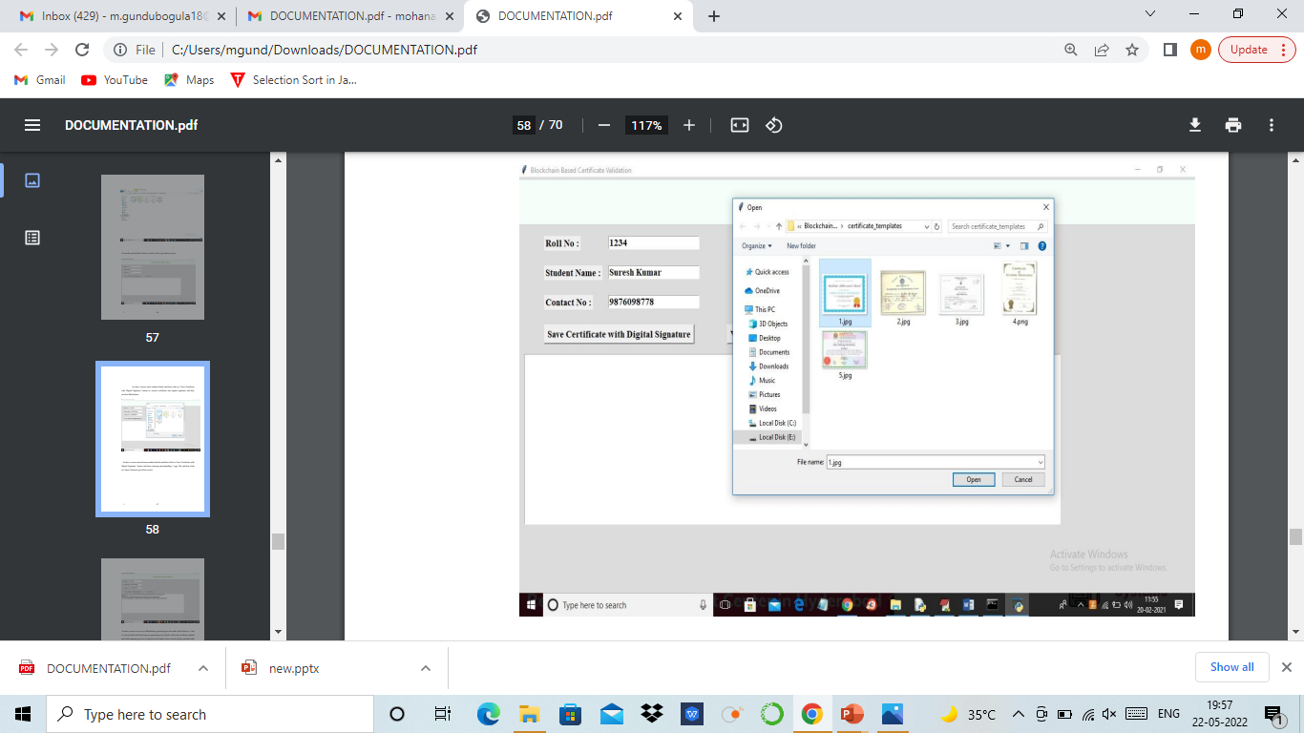

Slide 23
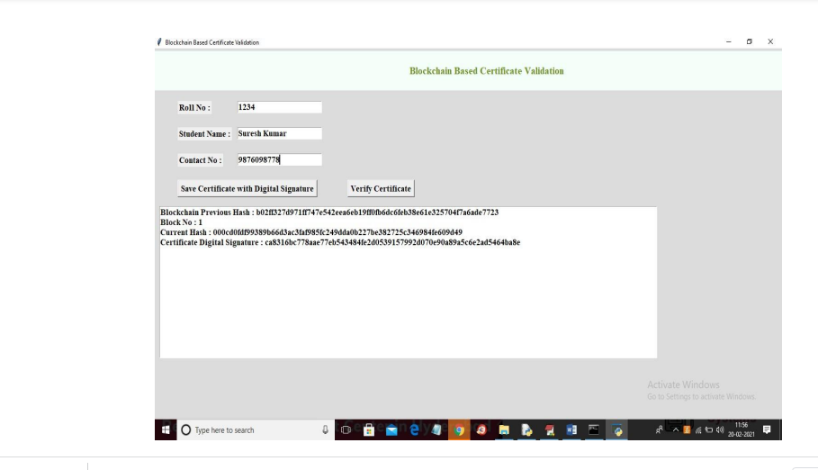

Slide 24
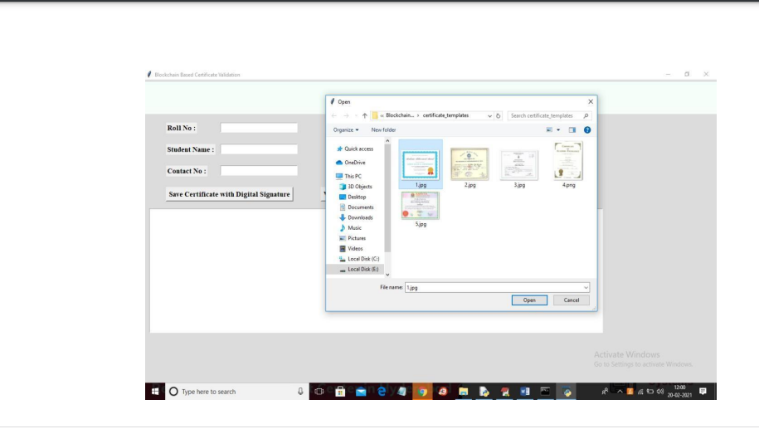

Slide 25
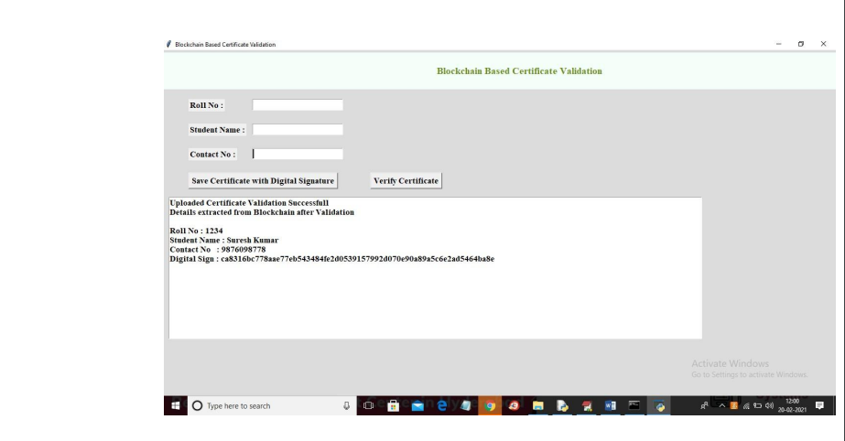

Slide 26
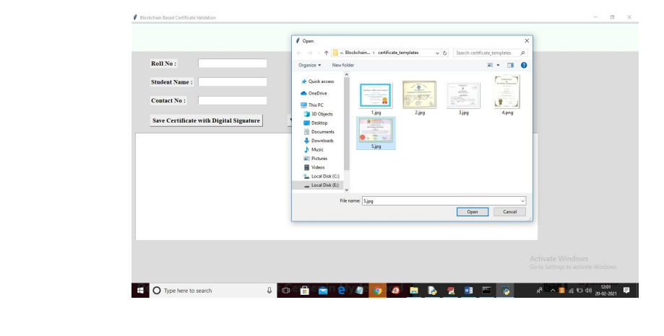

Slide 27
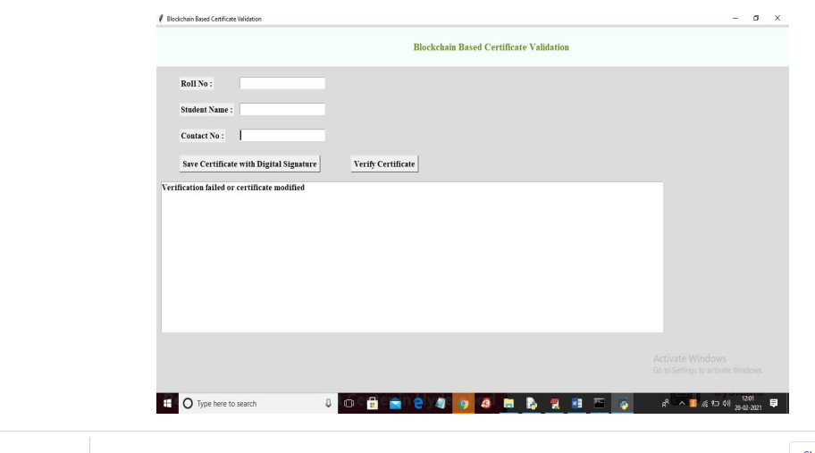

Slide 28
algorithms used
1. SHA(Secure Hash Algorithm):In cryptography, SHA-1 (Secure Hash Algorithm 1) is a cryptographic hash function which takes an input and produces a 160-bit (20-byte) hash value known as a message digest – typically rendered as a hexadecimal number, 40 digits long. It was designed by the United States National Security Agency, and is a U.S. Federal Information Processing Standard.
2. Mining:The mining model that an algorithm creates from your data can take various forms, including A set of clusters that describe how the cases in a dataset are related. K-mean Algorithm Apriori Algorithm etc.
3.Validation:An input validation algorithm is used to ensure that the data entered by a user is acceptable. For example, if a program were to ask for a score between 0 and 50, an input validation algorithm would be used to ensure that values below 0 and above 50 were rejected.

Slide 29
Advantages
To eliminate the time-consuming certificate verification process, for organizations.
To reduce the database frauds from various attacks.
To enhance the transaction clarity.
Improve the trust of the system
Authenticity
Certificates are securely stored on Blockchain Network.
Right person will get the Right Job Opportunity.
Issues related to fake certificates will be avoided.

Slide 30
continued..
Every time student needs to attest his/her certificate for the verification. This can be avoided.
• Certificates are easily accessible.
Once the certificates are deployed on the Blockchain Network that will became Immutable. So , Certificate Data will not be altered.
Manual Verification of the Certificate takes more time. This issue will be solved using Digital Certificate Verification System
Blockchain Contains Distributed Database So Security level is high Compare to other technology
Accessibility•
Security

Slide 31
DIsadvantages
Lengthy process.
Cost can be high.
In the phase of the multi-signature, the member of the academic committee member needs to remember the privatekey. However, the private key is a format of some irregular hexadecimal characters which is hard to remember.

Slide 32
Applications
Education field.
Peer-to-peer communication transaction applications.
Banking System.
Bitcoin transaction applications.
Zebpay transaction application

Slide 33
White box testing
White box testing is a test case design method that uses the control structure of the procedure design to derive test cases.
All independents path in a module are exercised at least once, all logical decisions are exercised at once, execute all loops at boundaries and within their operational bounds exercise internal data structure to ensure their validity.
Here the customer is given three chances to enter a valid choice out of the given menu. After which the control exits the current menu.

Slide 34
Black box testing
Black Box Testing attempts to find errors in following areas or categories, incorrect or missing functions, interface errors, errors in data structures, performance errors and initialization and termination errors.
Here all the input data must match, the data type to become a valid entry.

Slide 35
Black testing
Unit testing is essentially for the verification of the code produced during the coding phase and the goal is to test the internal logic of the module/program.
In the Genetic code project, the unit testing is done during coding phase of data entry forms whether the functions are working properly or not.
In this phase all the drivers are tested they are rightly connected or not.

Slide 36
Integration Testing
All the tested modules are combined into sub systems, which are then tested.
The goal is to see if the modules are properly integrated, and the emphasis being on the testing interfaces between the modules.
In the genetic code integration testing is done mainly on table creation module and insertion module.

Slide 37
Conclusion
In this paper, we proposed a solution to the problem of certificate forgery based on blockchain technology. Providing security to the data is very important. By using the unchallengeable property of blockchain, we can provide more security for data and reduce the certificate forgery. The application can allow the user to view and validate the certificate. This system guarantees information accuracy and security and easy for people to manage digital certificates.

Slide 38
Thank you

